Slide 1
Systems Administration

Slide 2
What is an operating system?
The executive manager that manages all of the hardware and all of the software.
Memory manager
Process manager
Device manager
File manager
Network manager
User command interface

Slide 3
The UNIX operating system
A portable operating system
A multi-tasking operating system
A multi-user computer operating system in a time- sharing configuration
Provides a standard command-line interface

Slide 4
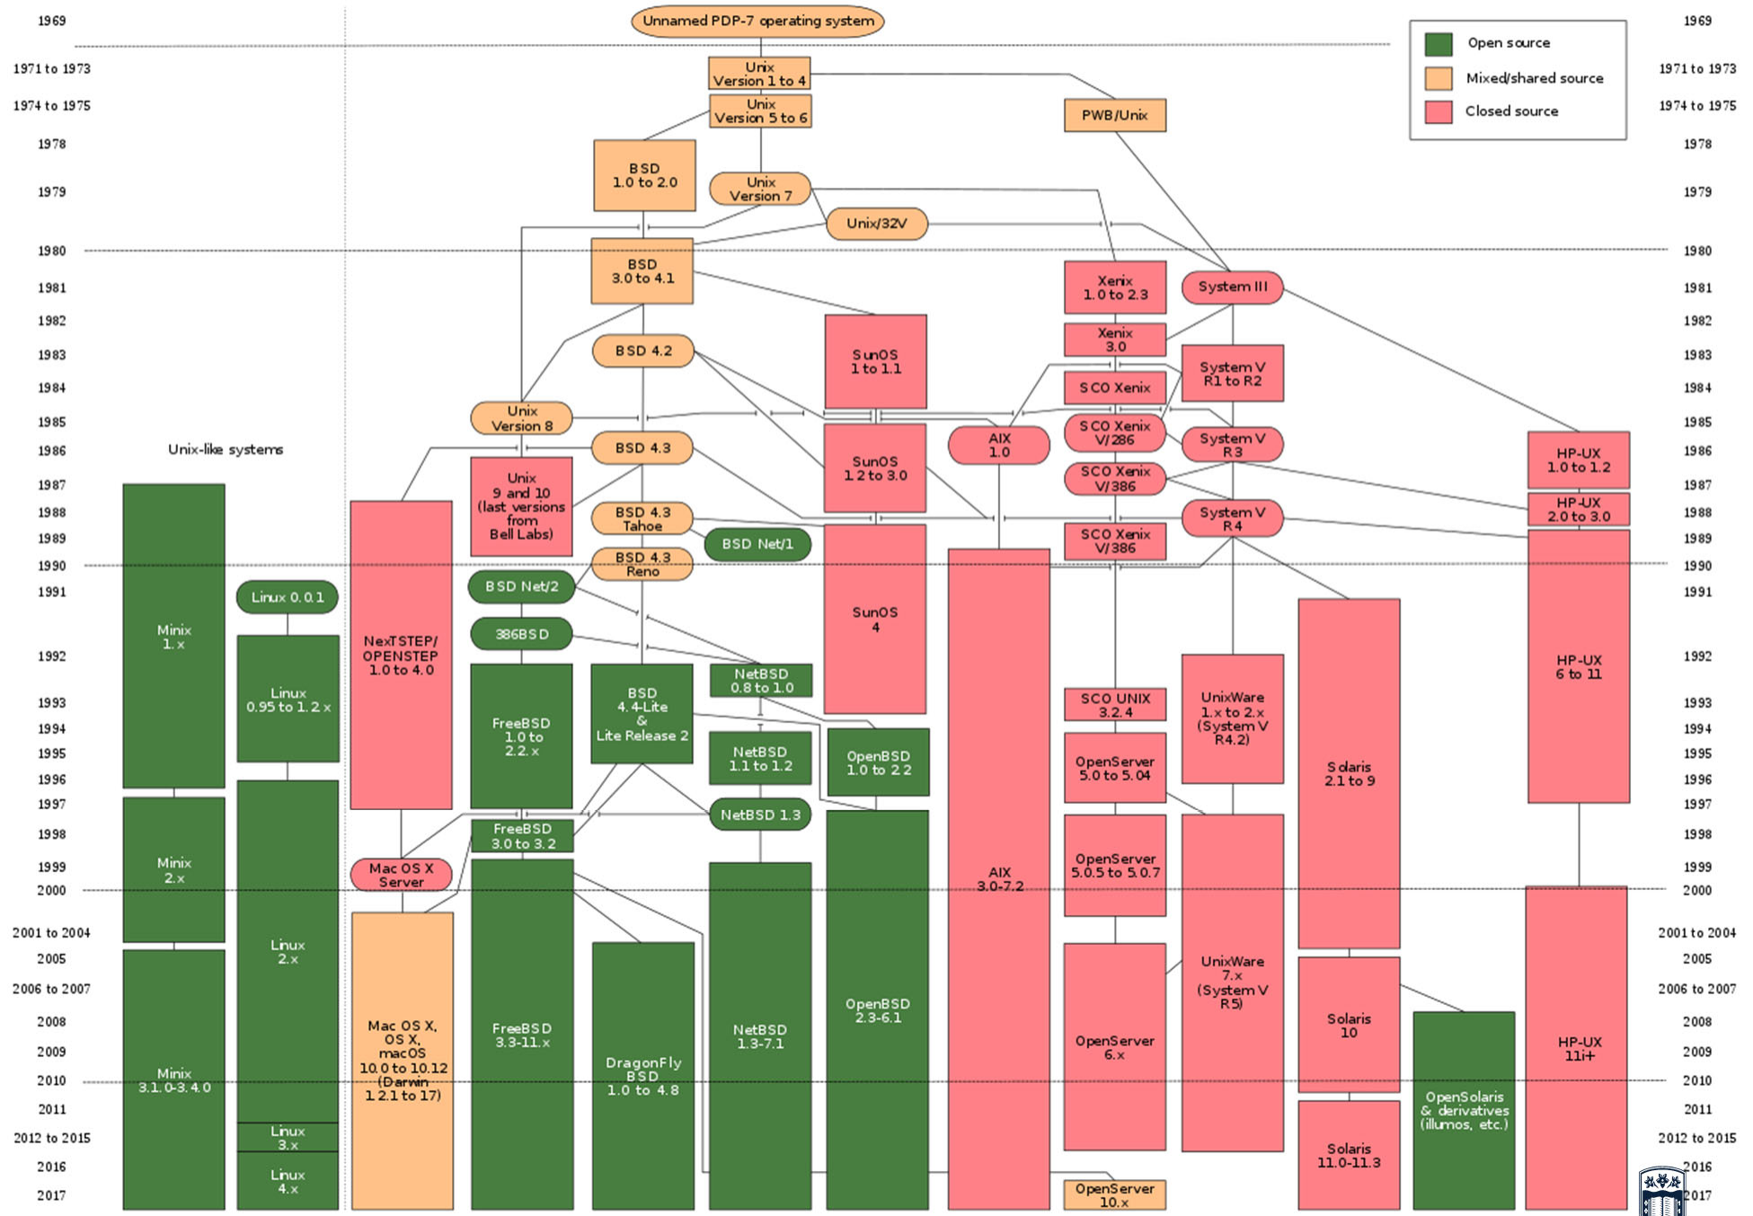



Slide 5
Friction between UNIX and Linux
Linux was developed in 1991 in Finland
Linux is a reimplementation and elaboration of the UNIX kernel.
Linux conforms to the POSIX standard.
Linux is free, open source, and cooperatively developed.
Many distributions: Debian, Linux Mint, Red Hat Enterprise, SUSE Linux Enterprise, Ubuntu, etc.
There are other UNIX flavors like AIX, FreeBSD, HP- UX, Solaris, Unixware

Slide 6
Accessing a UNIX system
The kernel is a core component that is loaded when you first turn you computer on.
The kernel loads all other components and serves to centrally control the activities of the computer.
A user interacts with the kernel through a channel called terminal.
After logging into a command-line terminal, the user receives a user interface called a shell.

Slide 7
userA
userA
userA
userA
terminal
terminal
terminal
terminal
shell
shell
shell
shell
UNIX kernel
Hardware

Slide 8
Common UNIX shells
Bourne shell (sh)
POSIX shell (sh)
Korn shell (ksh)
C shell (csh)
BASH shell (bash)
When a user logs into a graphical terminal
X Windows is loaded to provide graphical functionality
A desktop environment is loaded to standardise the look and feel of X Windows

Slide 9
Basic shell commands for a command- line terminal
Shell prompt
# for the root user
$ for all other users
Commands indicate the name of the program to execute and are case sensitive
Options are specific letters that start with a dash (-) and appear after the command name to alter the way the command works.
Arguments also appear after the command name, yet do not start with a dash. They specify the parameters that the command works upon.

Slide 10
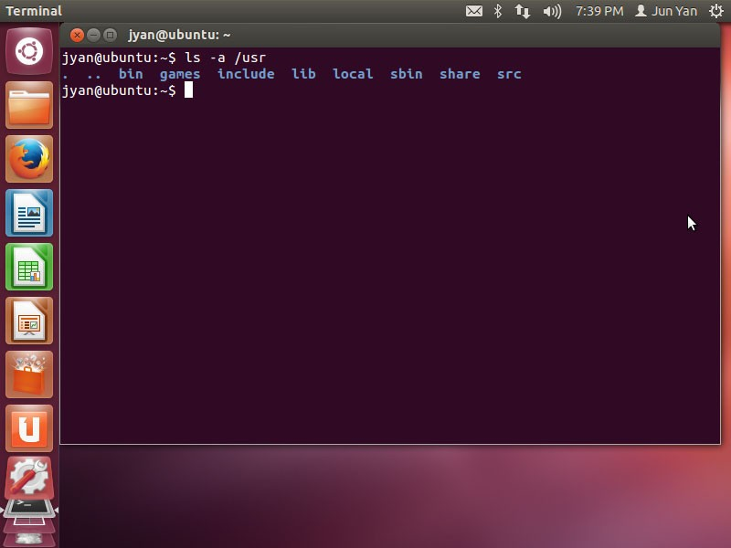

Slide 11
Some common UNIX command
Command | Description
ls | List your files
more filename | Show the first part of a file
emacs filename | Create and edit a file
vi filename | Create and edit a file
mv fn1 fn2 | Move a file
cp fn1 fn2 | Copy a file
rm filename | Remove a file
diff fn1 fn2 | Compare files, and show where they differ
wc filename | How many lines, words, and characters
chmod | Change the permission of a file

Slide 12
Some common UNIX command
Command | Description
gzip filename | Compress a file
gunzip filename | Uncompress a file
gzcat filename | Look at a gzipped file without having to gunzip it
cat filename | Look at the content of the file
lpr filename | Print
mkdir dirname | Make a new directory
cd dirname | Change the directory
pwd | Where you are
grep string fn(s) | Look for the string in the files.

Slide 13
Some common UNIX command
Command | Description
w | Who’s logged in and what they are doing
who | Who’s logged in and there they are coming from
finger | Display information on system users
last | Give a list of everyone’s logins
id | Display the user id and group id
uname -a | Display all information about the system
date | Current date and time
cal | Display the calendar of the current month
exit | Exit the current shell

Slide 14
Some common UNIX command
Command | Description
whoami | Return your usename
passwd | Change your password
ps | Display current processes
kill PID | Kill the process with the id you have
quota -v | Show what your disk quota is
echo | Print text to the terminal screen
mail | Send file by email
ssh | Open a secure connection
ftp | Upload or download file
!! | Repeat the previous command

Slide 15
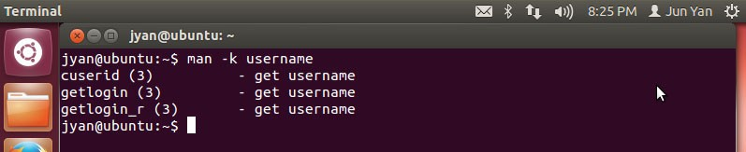
Obtain command help
It is impractical to memorise the syntax and use of more than 1000 UNIX commands.
Use the command man followed by the command name to retrieve the manual page of that command
man date
Search the manual pages by keyword
man –k keyword

Slide 16
Manual page section number
Section number | Description
1 1M X1M | Commands that any user may execute Command that only root user may execute X Windows commands that only the root user may execute
2 | System calls
3 3M 3F | Library routines and functions Mathematical functions Fortran functions
4 | File formats
5 | Miscellaneous
6 | Games
7 | Device drivers and interfaces

Slide 17
Shell metacharacters
Metacharacter | Description
$ | Shell variable
& | Background command execution
; | Command termination
< << > >> | I/O redirection
| | Command piping
* ? [] | Shell wildcards
‘ “ \ | Metacharacter quotes
` | Command substitution
() {} | Command grouping

Slide 18
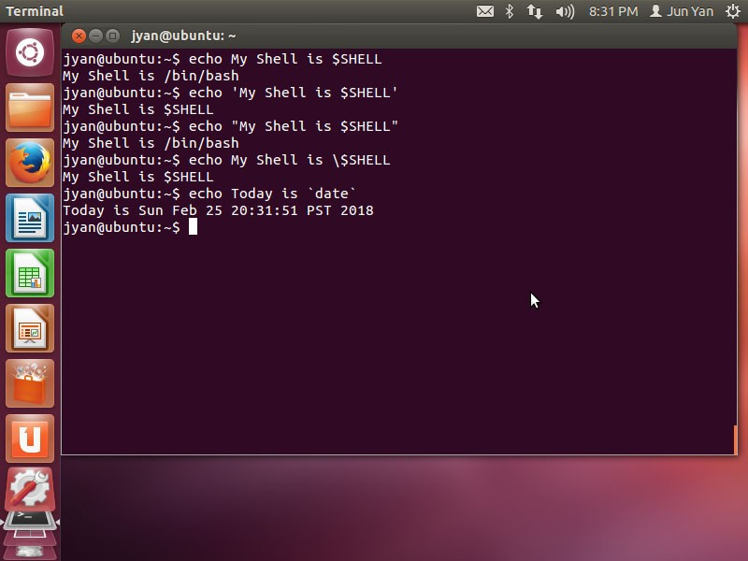

Slide 19
Command input and output
Your shell can manipulate command input and output. Command input and output are represented by labels known as file descriptors.
Standard input (stdin), descriptor number 0, by default refers to the user input typed on the keyboard
Standard output (stdout), descriptor number 1, by default refers to the terminal screen
Standard error (stderr), descriptor number 2, by default refers to the terminal screen

Slide 20
Redirection
Redirect standard output and standard error from the terminal screen to a file using the > shell metacharacter followed by the pathname of the file
The shell assumes standard output in the absence of a numeric file descriptor
You can also redirect both standard output and standard error to the same file using special notation (see next slide)
You can redirect a file to the standard input of a command using the < metacharacter

Slide 21
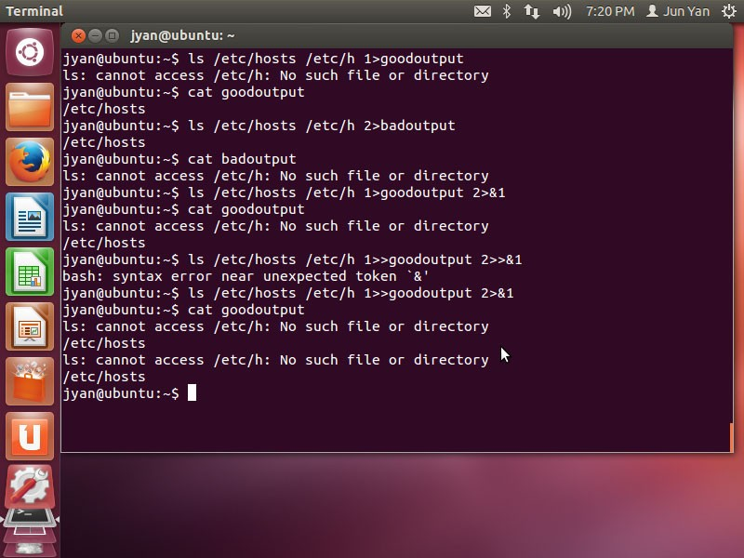

Slide 22
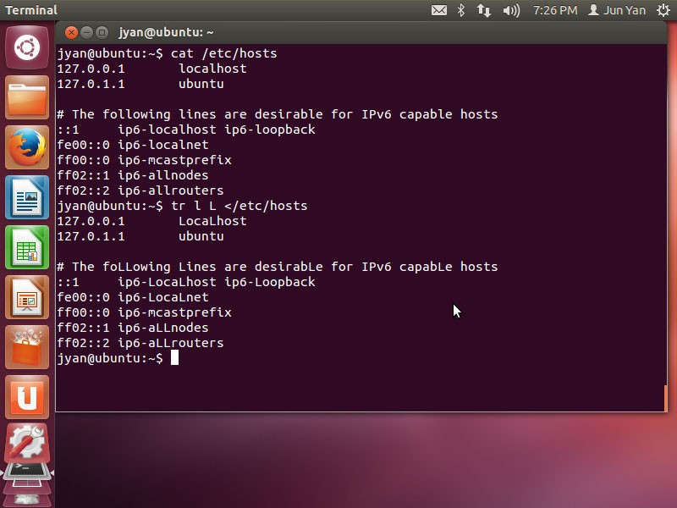

Slide 23
Pipes
To connect the stdout of one command to the stdin of another, use the | symbol, commonly known as a pipe
You can use more than one | metacharacter on the command line to pipe information from one command to another
Use the tee command to write to the standard output and a file
You can also combine the redirection and pipe

Slide 24
Combine redirection and piping
You can also combine redirection and piping together
Input direction must occur at the beginning of the pipe
Output direction must occur at the end of the pipe

Slide 25

Filter
Any command that can take from standard input and give to standard output is called a filter.
 | Command | Description
 | cut | Prints selected portions of its input lines
 | sort sort –r | Sorts lines in a file (ASCII) Reverse sorts lines in a file (ASCII)
 | wc wc -l wc -w wc –c | Counts the number of lines, words, and characters in a file
 | pr pr –d | Formats a file for printing Formats a file double spaced
 | tr | Replaces characters in the text of a file
 | grep | Displays lines in a file that match a regular expression
 | nl | Numbers lines in a file

Slide 26
cut
The cut command prints selected portions of its input lines. It’s commonly used to extract delimited fields.
The default delimiter is <Tab>
You can change delimiters with the –d option
The –f options specifies which fields to include in the output
How to enumerate the system’s users?

Slide 27
Sort
Option | Meaning
-b | Ignore leading whitespace
-f | Case insensitive sorting
-k | Specify the columns that form the sort key
-n | Compare fields as integer numbers
-r | Reverse sort order
-t | Set field separator (the default is whitespace)
-u | Output unique records only
How to reverse sort the /etc/group file by its group ID?

Slide 28
Exercises
List /etc page by page
Replace all lowercase a with uppercase A in
/etc/passwd and display the content in the terminal screen page by page
Replace all lowercase a with uppercase A in
/etc/passwd, sort the contents by the first character on each line, and then save the results to
/home/jyan/results

Slide 29
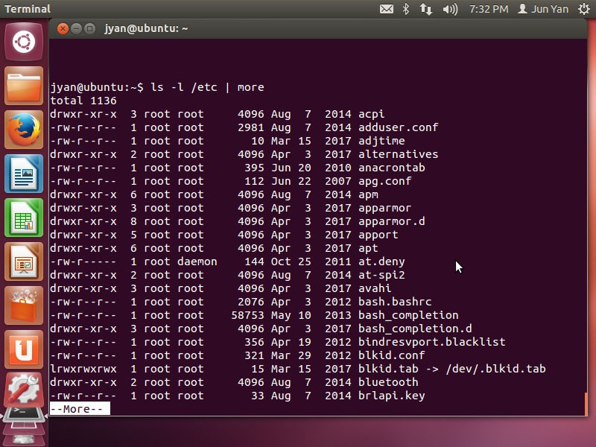

Slide 30
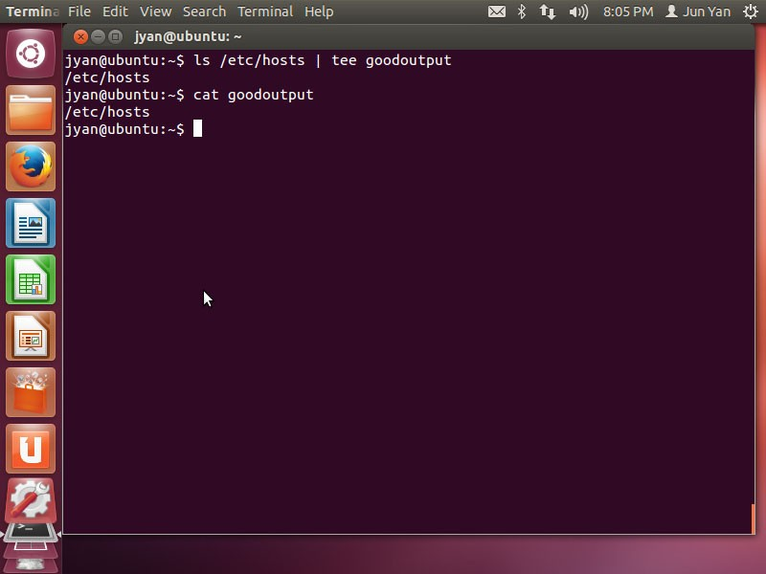

Slide 31
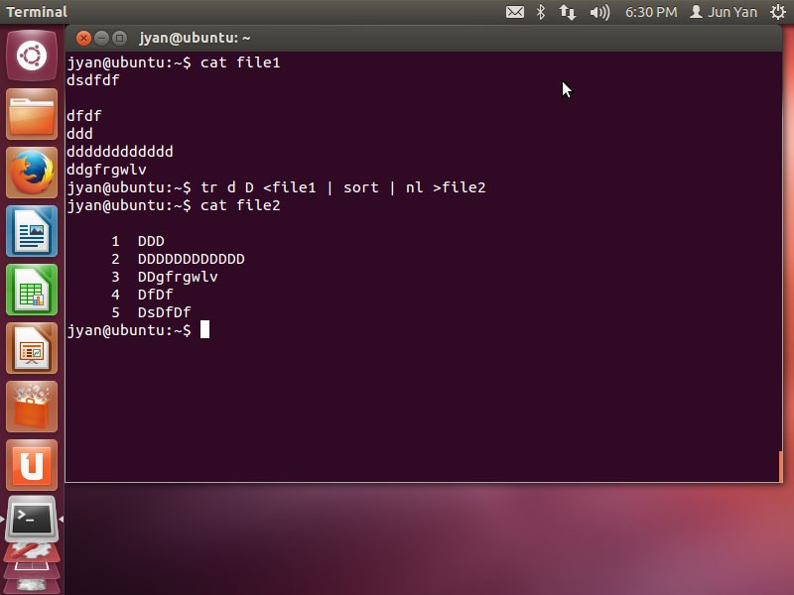

Slide 32
Shell variables
Environment variables are typical set by the system and contain information that the system and programs access regularly
User-defined variables are created by users
There are other special variables that are useful when executing commands and creating new files and directories

Slide 33
Environment variables
Use the set command or env command to see a list of environment variables and their values
HOME: the absolute pathname to the user’s home directory
PWD: the present working directory in the directory tree
PATH: a list of directories to search for executable programs
SHELL: the absolute pathname of the current shell
LOGNAME: the username of the current user used when logging into the shell
TZ: the time zone for the system

Slide 34
User-defined variables
Variable names are prefixed with a dollar sign when their values are referenced
– echo $MYVAR
You can surround the variable name with curly braces
– echo “I am the ${REV}th in the competition.”
Variables created in the current shell are only available to the current shell, not to the subshells, unless you export them

Slide 35
Setting variables
To change the value of a variable, specify the variable name immediately followed by a equal sign (=) and the new value
In some distributions, you must use the setenv command followed by the variable name and the new value.
Variable names can contain alphanumeric characters, dash (-) or underscore (_)
They must not start with a number
They are typically capitalised to follow convention

Slide 36
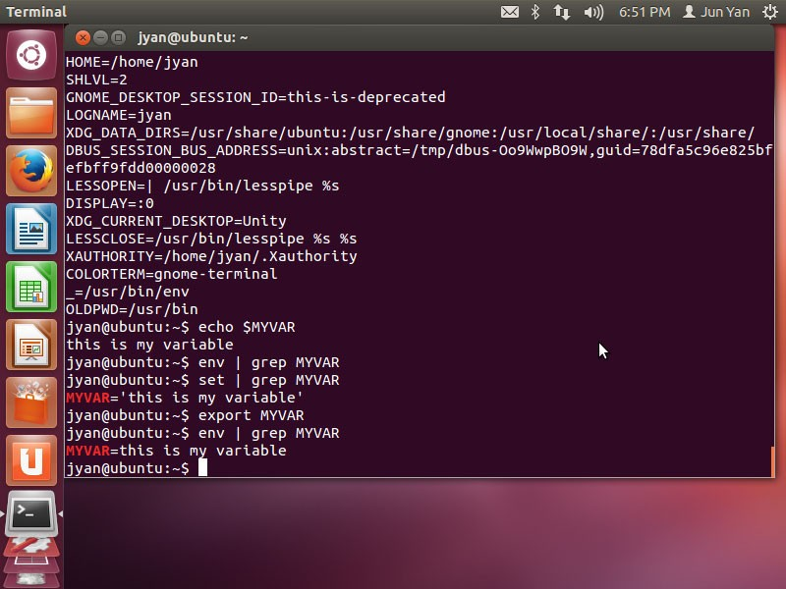

Slide 37
Other variables
Other variable are not displayed by set or env commands, and perform specialised functions
UMASK is a special variable (discussed in the next lecture)
Command aliases are shortcuts to commands stored in special variables that can be created and viewed by the alias command
alias dw=“date;who”

Slide 38
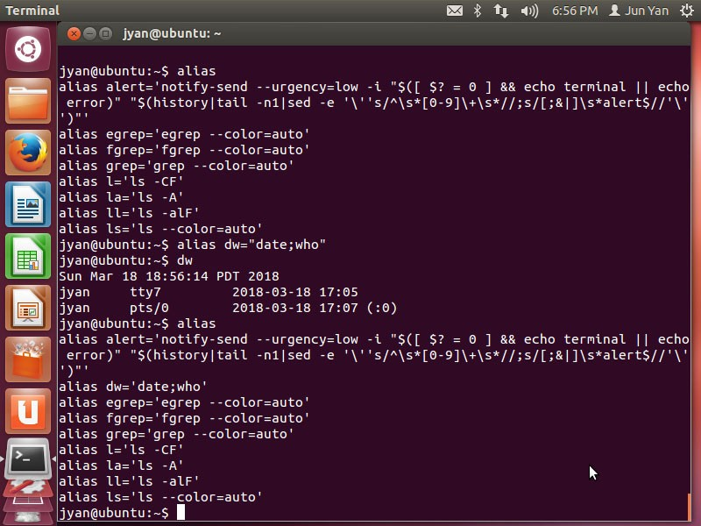

Slide 39
Bash scripting
Bash scripts automate things you’d otherwise be typing on the command line
The fist line is known as the “shebang” statement and declares the text file to be a script for interpretation by bash:
#!/bin/bash
Comments start with a hash mark (#)
Invoke the shell as an interpreter or turn on the execution bit of the script to run the script
No need to set the file’s extension but some people use
.sh

Slide 40
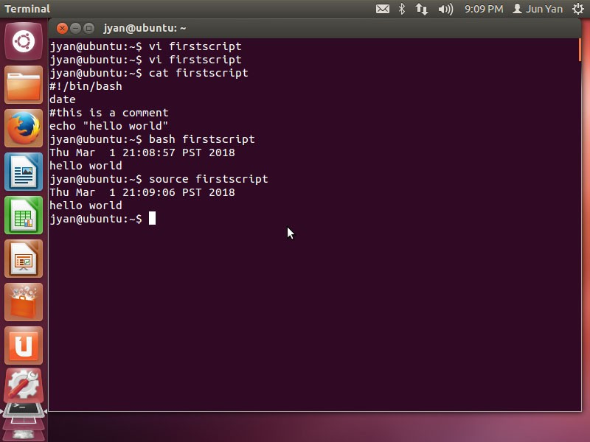

Slide 41
Command-line arguments and functions
Command-line arguments to a script become variables whose names are numbers
$1 is the first command-line argument, and so on
$0 is the name by which the script was invoked
$# contains the number of command-line arguments that were supplied
$* contains all the arguments at once

Slide 42
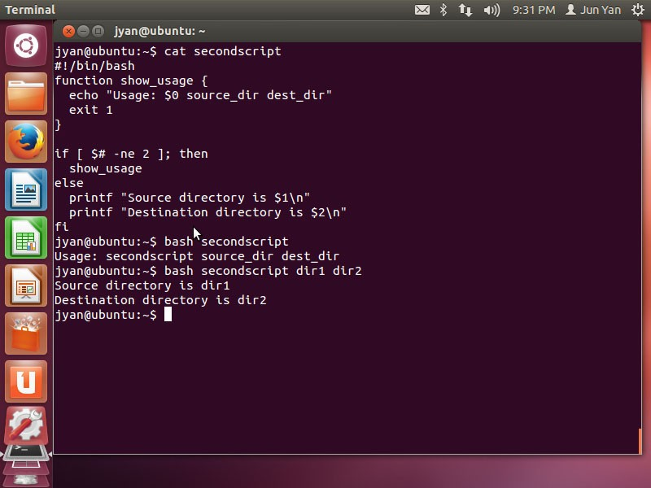

Slide 43
Variable scope
Variables are global within a script
Functions can create their own local variables with a local declaration
– local variablename

Slide 44
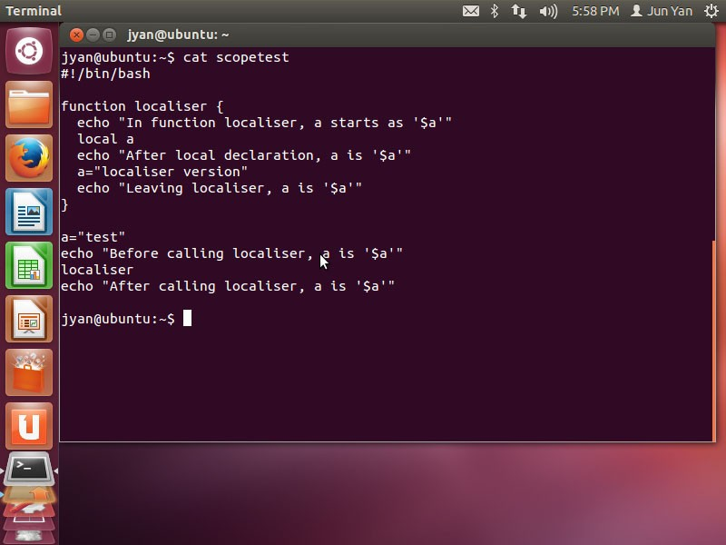
What is the output

Slide 45
Control flow
if-then and if-then-else
The terminator for an if statement is fi
The elif keyword to mean “else if”
See the example in the next slide. Both the peculiar [] syntax for comparisons and the integer comparison operators (e.g., -eq) are inherited from the original Bourne Shell’s channelling of /bin/test.
The brackets actually invoke test and are not a syntactic requirement of the if statement

Slide 46
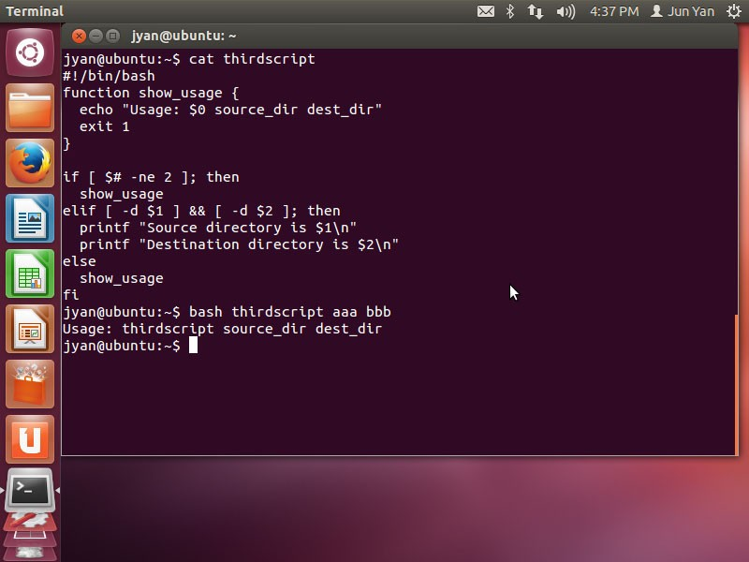

Slide 47
Elementary bash comparison operators
String | Numeric | True if
x = y | x –eq y | x is equal to y
x != y | x –ne y | x is not equal to y
x < y | x –lt y | x is less than y
x <= y | x –le y | x is less than or equal to y
x > y | x –gt y | x is greater than y
x >= y | x –ge y | x is greater than or equal to y
-n x | - | x is not null
-z x | - | x is null

Slide 48
bash file evaluation operators
Operator | True if
-d file | file exists and is a directory
-e file | file exists
-f file | file exists and is a regular file
-r file | You have read permission on the file
-s file | file exists and is not empty
-w file | You have write permission on the file
file1 –nt file2 | file1 is newer than file2
file1 –ot file2 | file1 is older than file2

Slide 49
Loops
bash’s for…in construct takes some action for a group of values
Any whitespace-separated list of things, including the contents of a variable, works as a target of for…in
for loop
for (( i=0; i < $count; i++)); do
… done
while loop
See examples in the next a few slides

Slide 50
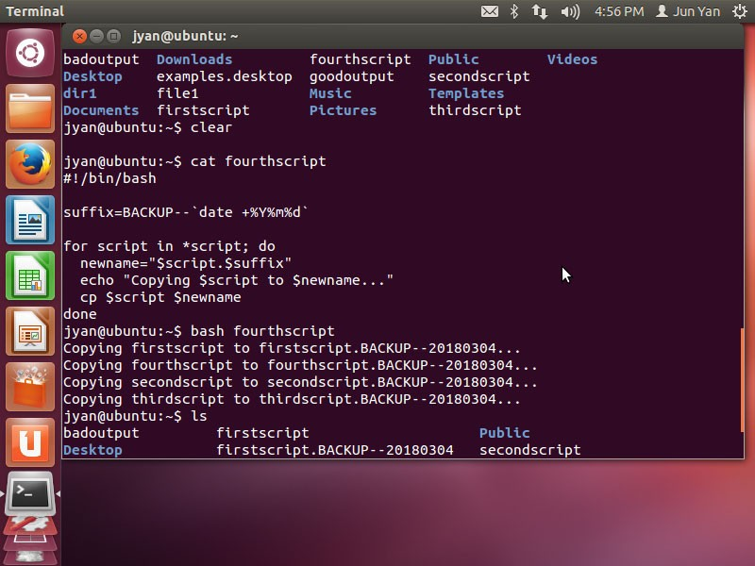

Slide 51
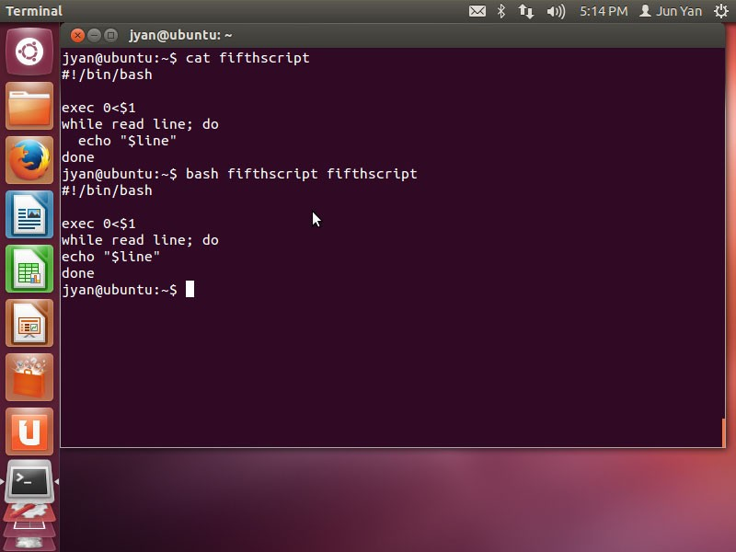

Slide 52
Arrays
Arrays are not often used in bash.
Literal arrays are delimited by parentheses, and the elements are separated by whitespace
example=(aa bb cc dd)
Use ${array_name[subscript]} to access individual elements
echo ${example[1]}
The subscripts * and @ refer to the array as a whole
${example[@]}
${#example[@]} yields the number of elements in the array

Slide 53
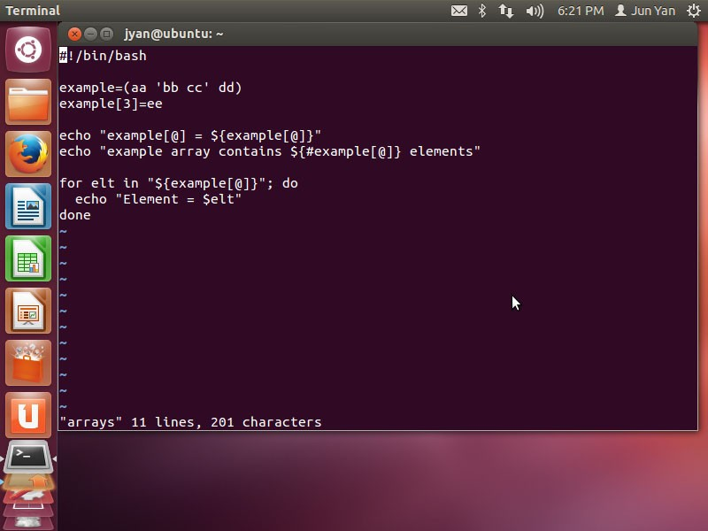
What is the output?

Slide 54
Regular expressions
Regular expressions enable you to specify a certain pattern of text within a text document.
Similar to wildcard metacharacters but interpreted by a text tool program.
More regular expression metacharacters are available than wildcard metacharacters.

Slide 55
Symbol | Description
. | Matches any one character
* | Matches zero or more occurrences of the previous character.
? | Matches zero or one occurrence of the previous character.
+ | Matches one or more occurrences of the previous character.
[chars] | Matches any character from a given set, e.g., [a-z]
[^chars] | Matches any character not in a given set, e.g., [^a-z]
(|) | Matches either the element to its left or to its right.

Slide 56
Symbol | Description
^ | Matches the beginning of a line.
$ | Matches the end of a line.
\w | Matches any word character. [a-zA-Z0-9_]
\s | Matches any whitespace character.
\d | Matches any digit. [0-9]
{n} | Matches exactly n instances of the preceding element.
{min,} | Matches at least min instances of the preceding element.
{min,max} | Matches any number of instances of the preceding element from min to max.

Slide 57
Examples
^\d{4}$
Letter[^1238]
(mother|father)
M[ou]’?am+[ae]r ([Aeae]|[-
])?[GKQ]h?[aeu]+([dhz]|[dhz]?){1,2}af[iy]

Slide 58
The grep command
Global Regular Expression Print searches for information using regular expressions
It displays the lines of text that match extended regular expressions.
grep “hello” file1
grep –v “hello” file1
grep –i “hello” file1
grep “^I ” file1

Slide 59
Perl programming
Perl is a scripting language that offers vastly more power than bash
It is a better choice for systems administration than traditional programing language (the other choice is Python)
Perl can do more in fewer lines of code, with less painful debugging
Perl’s catch phrase is that “there’s more than one way to do it”

Slide 60
Perl programming
Perl statements are separated by semicolons
Comments start with a hash mask (#)
Blocks of statements are enclosed in curly braces
Lines in a perl script are not shell commands; they are perl codes
The fist line is known as the “shebang” statement and declares the text file to be a script for interpretation by perl:
– #!/usr/bin/perl

Slide 61
Variables and arrays
Perl has three fundamental data types:
Scalars: scalar variables start with $
$a=“this is an example”;
$count=0;
Arrays: array variables start with @
@items=(“socks”, “shoes”, “shorts”);
Array subscripting begins at zero, the index of the highest element is $#items
The array @ARGV contains the script’s command-line arguments
Hashes (aka associative arrays): hash variables start with
%

Slide 62
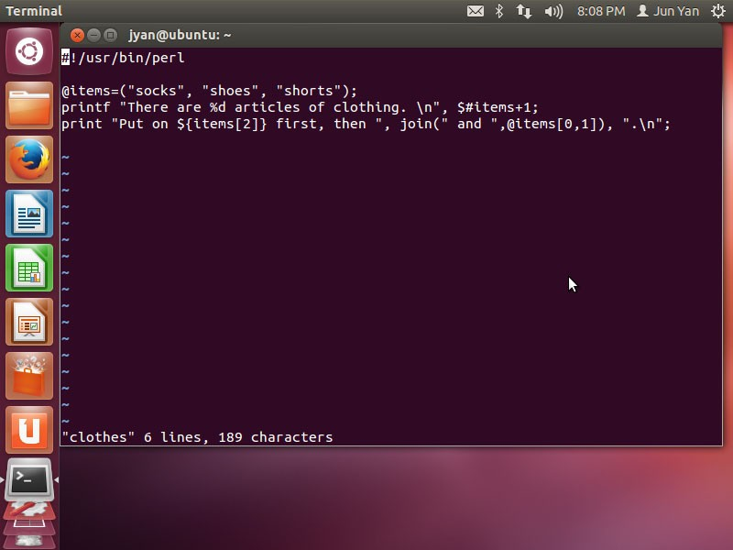
What is the output?

Slide 63
Hashes
A hash represents a set if key/value pairs.
In other words, a hash is an array whose subscripts are arbitrary scalar values
Subscripting is indicated with curly braces rather than square brackets
– $myhash{‘ron’}

Slide 64
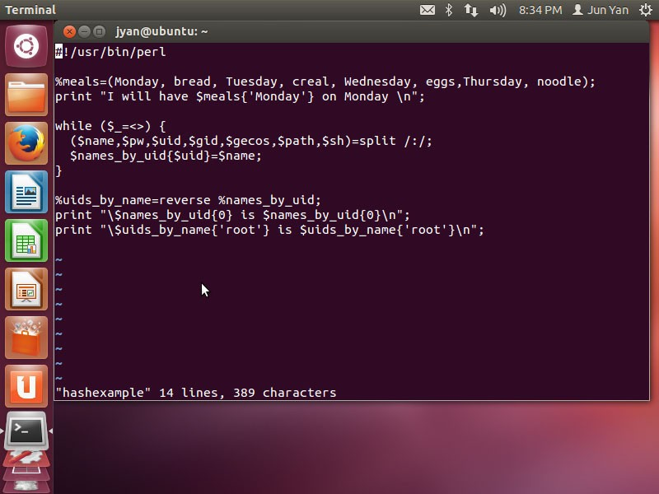
What is the output?

Slide 65
Elementary Perl comparison operators
String | Numeric | True if
x eq y | x = y | x is equal to y
x ne y | x != y | x is not equal to y
x lt y | x < y | x is less than y
x le y | x <= y | x is less than or equal to y
x gt y | x > y | x is greater than y
x ge y | x >= y | x is greater than or equal to y
You get all the file-testing operators shown in Slide 48 except for the –nt and –ot operators

Slide 66
Control flow
Control flow in Perl is very similar to that in bash
if construct has no then keyword or terminating word

Slide 67
Input and output
When you open a file for reading or writing, you define a filehandle to identify the channel
open($fh, ‘<’, $inputfilename) || die “Couldn’t open file.”;
open($fh, ‘>’, $ouputfilename) || die “Couldn’t open file.”;

Slide 68
Questions?

